Slide 1
The Age of
Imperialism
(1850 – 1914)

Slide 2
Imperialism:
building empires by
expanding territory
and gaining colonies

Slide 3
Economic Origins of Imperialism
The Industrial Revolution
  Industrialized nations took control of less developed nations
    To gain raw materials for industry
      Cotton, coal, metals, etc.
    To gain markets for goods
      Manufactured goods could be sold in the colonies

Slide 4
Political and Social
Origins of Imperialism
  Nationalism
    Competition between industrial nations led to a race for overseas empires
  The “White Man’s Burden”
    Many believed it was their duty to “civilize” people of other nations by introducing Christianity and Western culture
  Social Darwinism
    Many claimed it was natural for “the weak to be taken over by the strong”

Slide 5
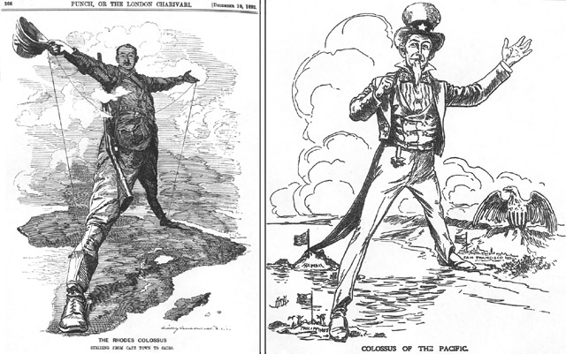
Major Imperial Powers
Great Britain
France
Germany
Russia
The United States
Japan

Slide 6
Imperialized Areas
Powerful industrial nations established empires in:
  Africa
  Asia
  Oceania (Australia, New Zealand,
and surrounding islands)

Slide 7
Cultural Reasons
Prove superiority
Social Darwinism--Many claimed it was natural for “the weak to be taken over by the strong”
The “White Man’s Burden”
    Many believed it was their duty to “civilize” people of other nations by introducing Christianity and Western culture

Slide 8
Religious
  Spread Christianity

Slide 9
Military
Gain strategic areas, gain military power

Slide 10
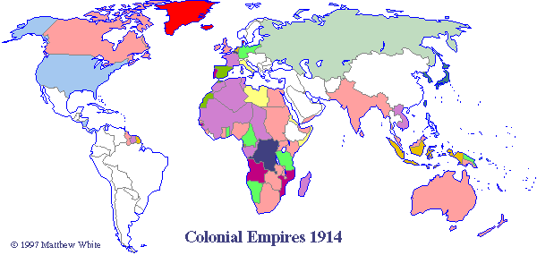
Imperialism in 1914

Slide 11
Europeans
Colonize Africa

Slide 12
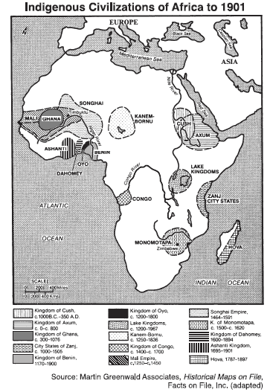

Slide 13
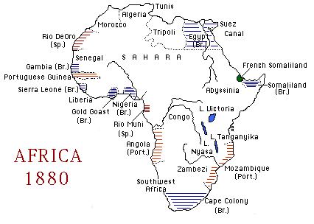

Slide 14
The Scramble for Africa
During the late 1800s Europeans began exploring the interior parts of Africa
By the 1880s, European nations were racing to colonize African lands

Slide 15
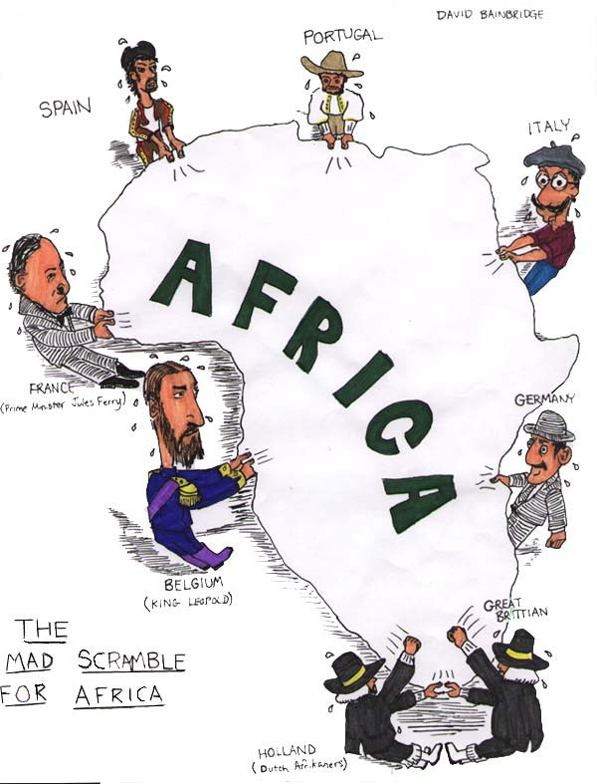

Slide 16
The Berlin Conference
European nations met in Berlin, Germany to settle arguments over African lands
European powers divided all of Africa (except Ethiopia and Liberia) and drew up new borders
  Did not consider ethnic or language differences of African tribes
  Africans had no say in the decisions

Slide 17
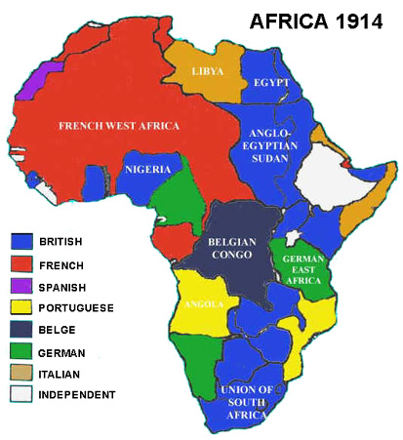

Slide 18
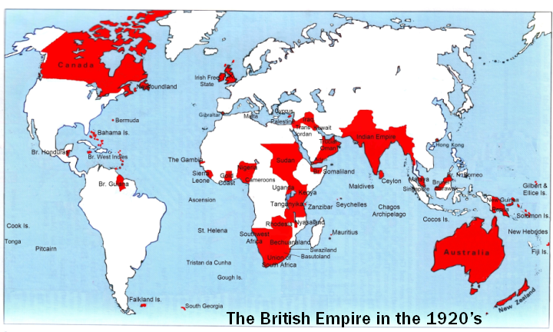
The British Empire (1920s)
“The Sun never sets on the British Empire”

Slide 19
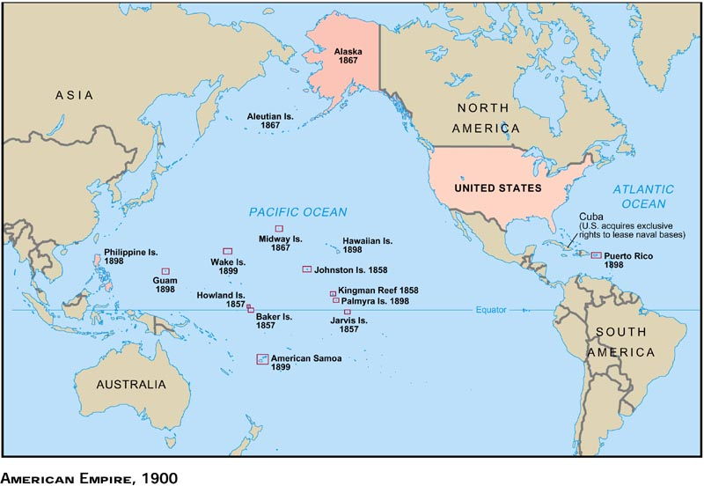
The United States’ Empire (1900)

Slide 20
The Spanish-American War (1898)
Causes
  U.S. wanted to help Cuba win independence from Spain
    U.S. had economic interests in Cuba
    U.S. saw Spain’s control of Cuba as a test of the Monroe Doctrine
      Monroe Doctrine: stated that the Americas were off limits to further European colonization
  U.S. wanted to build an empire
    U.S. needed raw materials and markets for its goods
    Strong nationalism
      Americans wanted their nation to be powerful, wealthy, and competitive with the European powers
  U.S. newspapers blamed Spain for explosion of USS Maine
Effects
  U.S. quickly defeated Spain and became a world power
  U.S. acquired Puerto Rico, Cuba, the Philippines, and Guam
    U.S. temporarily occupied Cuba and set up a military government
    Cuba and the Philippines eventually gained independence

Slide 21
Intervention in Latin America
Roosevelt Corollary to the Monroe Doctrine
  Declared the U.S. as the police power of the Western Hemisphere
  Established U.S. “economic imperialism” throughout Latin America
Panama
  U.S. supported Panama’s independence from Colombia in exchange for the right to build and control the Panama Canal

Slide 22
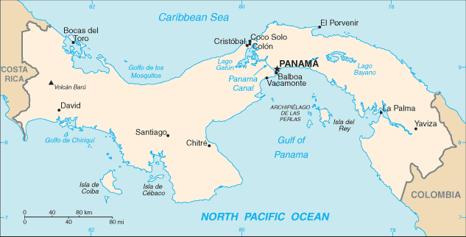
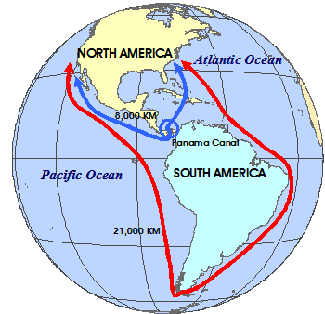
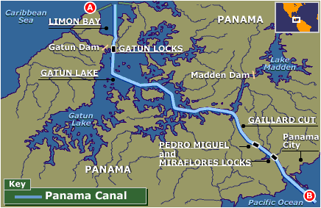
Panama Canal

Slide 23
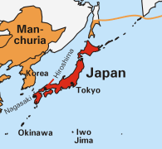
Japanese Empire (1905)

Slide 24
Japan Opens Up
Since the 1600’s, Japan had practiced a policy of isolationism, in which it cut itself off from the outside world
In the 1850’s, the United States Navy forced Japan to open its ports to trade

Slide 25
Japanese Imperialism
Modernized economy and military
  Japan built factories and needed raw materials to make manufactured goods
  Japan quickly built a modern navy
War with China
  Japan and China competed for trading rights in Korea
  Japan defeated China and took control of Korea and Manchuria
Russo-Japanese War
  Russia tried to step in and take control of Korea and Manchuria
  Japan defeated Russia and became a world power

Slide 26
Resistance
to Imperialism

Slide 27
Resistance to Imperialism
Natives of Africa, Asia, and Oceania
  Liked improvements made by imperialist rulers
    roads, railroads, schools, peace, etc.
  Disliked the way they were treated by rulers
    Wanted to rule themselves
    Disliked racism of imperialist nations
    Felt foreign culture was being forced on them
  Sometimes fought against imperialism
    Most natives were easily defeated
      Industrialized nations were more united and had better weapons and technology
    Some natives put up fierce resistance

Slide 28
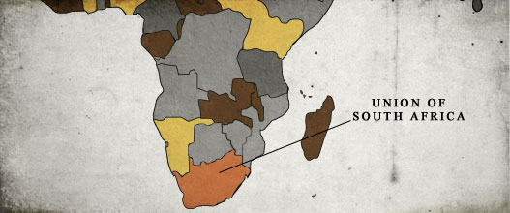
South Africa

Slide 29
Europeans in South Africa
The Dutch established a colony in South Africa
After defeating the Dutch in a war, Great Britain took control of South Africa

Slide 30
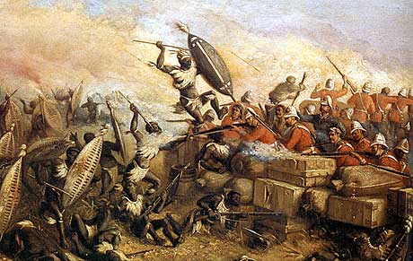
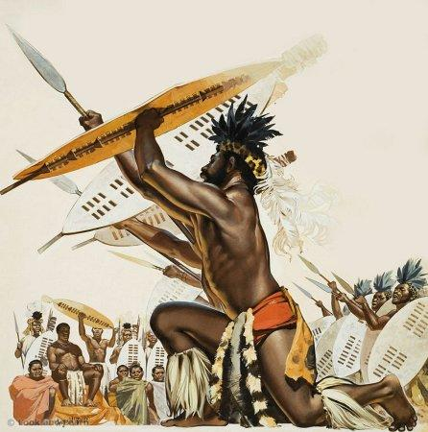
The Zulu War
The British and the Zulus (a native tribe of Southern Africa) fought a war over land
The Zulus put up fierce resistance and won a major battle even though they were fighting with spears against guns
Eventually the British overwhelmed and defeated the Zulus and took control of their lands

Slide 31
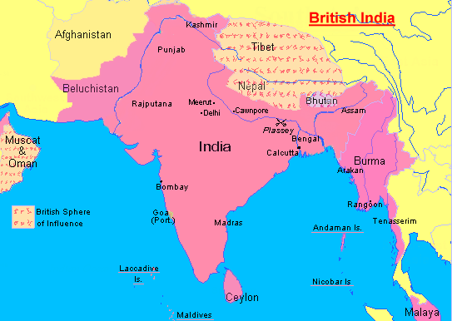
India
“The Jewel of the Crown” for the British Empire

Slide 32
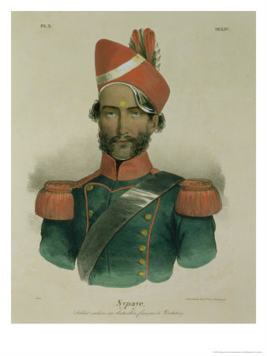
British India
The British East India Company was given permission by the British government to run the colony of India
  Indian soldiers called Sepoys were hired by the East India Company to protect their business
    Most Sepoys were Muslim or Hindu
Indians did not have same rights as British
Many British looked down on Indians because of their race

Slide 33
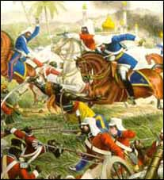
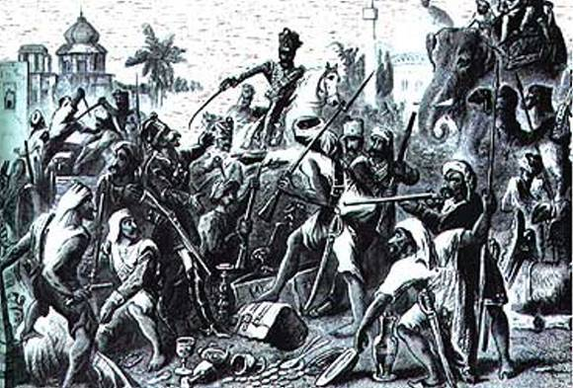
The Sepoy Rebellion
Sepoys were ordered to use rifle cartridge that was rumored to be greased with cow and pig fat
  They refused to follow orders and were being thrown in jail
    Hindus believe cows are sacred animals
    Muslims believe pigs are unclean
Sepoys rioted and captured part of India
  It took over 1 year for the British to regain control

Slide 34
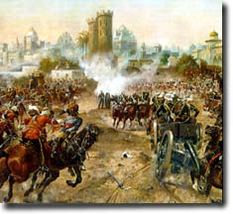
Sepoy Rebellion
Results:
  Rebellion was unsuccessful
  British government took full control of India
  Indian nationalism and desire for independence grew
  British mistreatment Indians grew

Slide 35
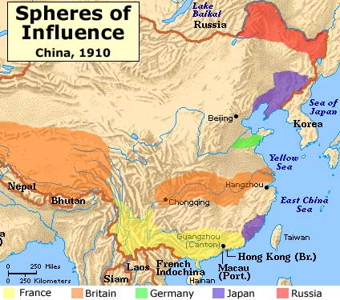
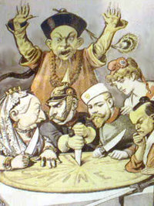
China

Slide 36
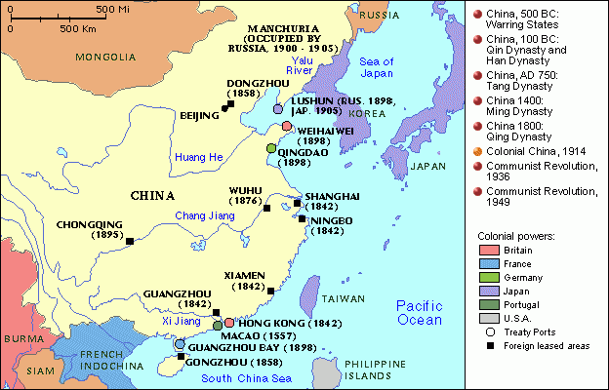
China
In the early 1900’s China’s government was very weak and could not keep other countries from taking control of its ports
Open Door Policy: the policy of allowing all nations access to trade in China
  Foreign countries controlled trade and had a great deal of influence in China
  Missionaries spread Christianity to Chinese

Slide 37
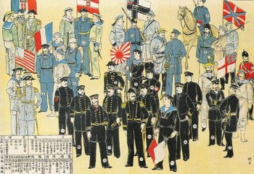
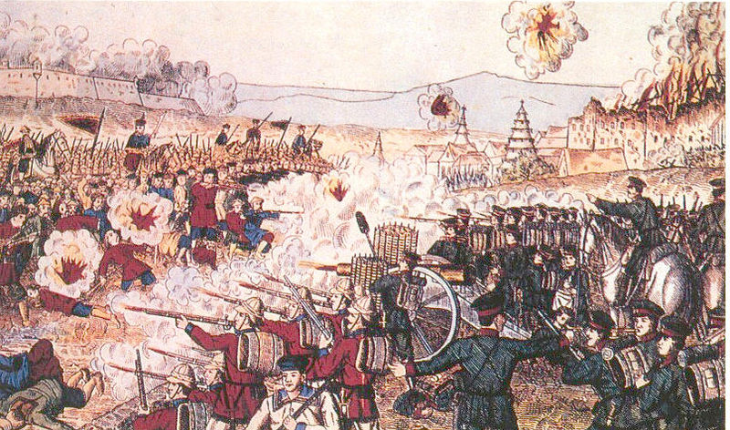
The Boxer Rebellion
Righteous and Harmonious Fists: a group of Chinese warriors (called “Boxers” by Europeans) who wanted to end foreign influence and the spread of Christianity in China
Boxers attacked Chinese Christians and foreigners
  Several nations sent soldiers to protect their interests
  The foreigners defeated the Boxers
Results
  Foreign powers gained even more control of China
  Growth in Chinese nationalism

Slide 38
The End
Special thanks to:
  http://users.erols.com/mwhite28/1907powr.htm
  http://www.saburchill.com/history/chapters/empires/0053.html
  Google Images (contributions from various artists)
  Created by Ben Bindewald

